Slide 1
Web Technology
Unit 1
Properties in CSS
By:
Dr. Vipin Kumar
Associate Processor,
Department of Computer Applications,
KIET Group of Institutions, NCR, Ghaziabad, UP, India

Slide 2
Color
background-color:rgb(255, 0, 0);
background-color:rgba(255, 0, 0,0.2);
background-color:#000000; (Hexa Value)
background-color:hsl(240, 100%, 50%)
  Hue is a degree on the color wheel from 0 to 360.
  Saturation is a percentage value.
  Lightness is also a percentage.

Slide 3
CSS Background
background-color:#AFC
opacity: 0.3; (0.0 to 1.0)
background-image: url(“small.gif”);
background-repeat: repeat-x|repeat-y|no-repeat
background-attachment: fixed|scroll
background-position: top|bottom|right|left

Slide 4
TEXT Formatting
text-align:center|left|right|justify
text-decoration:none|overline|line-through |underline|blink
text-transform:uppercase|lowercase|capitalize
text-indent:50px; color: blue;
letter-spacing: 3px;
line-height: 0.8;
word-spacing: 10px;
white-space: nowrap;
text-shadow: 2px 2px 5px red;

Slide 5
Font Formatting
font-family:Times
font-style:normal|italic|oblique
font-size:40px
font-variant:normal|small-caps|inherit
font-weight:normal|bold|bolder|lighter|900

Slide 6
Link Formatting
a:link {color:#FF0000;}
a:visited {color:#00FF00;}
a:hover {color:#FF00FF;}
a:active {color:#0000FF;}

Slide 7
List Formatting
ul.b {list-style-type: none|circle|square}
ol.c {list-style-type: none|upper-roman|lower-alpha}
list-style-image: url('sqpurple.gif')
list-style-position:inside|outside
float:left

Slide 8
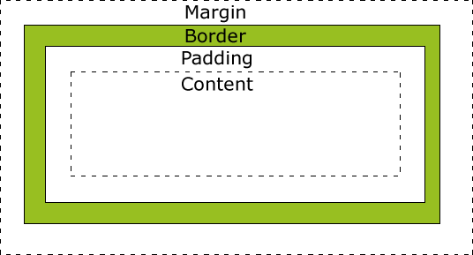
Box Model Formatting
width:250px;
padding:10px;
border:5px solid gray;
margin:10px

Slide 9
Border Formatting
border-style: none|dotted|dashed|solid| double|groove|ridge|inset|outset;
border-width:5px;
border-color:red;
border-top-style:dotted;
border-right-style:solid;
border-bottom-style:dotted;
border-left-style:solid;
border-radius: 5px;

Slide 10
Margin Formatting
margin-top:100px|auto;
margin-bottom:100px|auto;
margin-right:50px|auto;
margin-left:50px|auto;

Slide 11
Padding Formatting
padding-top:25px;
padding-bottom:25px;
padding-right:50px;
padding-left:50px;

Slide 12
Width and Height
height: 200px;
width: 50%;
max-width: 500px;

Slide 13
Table Properties
border-collapse: collapse;
border: 1px solid black;
width: 100%; height: 50px;
text-align: left; (left, center, right)
vertical-align: bottom; (top, button, middle)
padding: 15px;

Slide 14
Display & Position Property
display: inline; (none, block, inline)
position: static;
  static
  relative
  fixed
  absolute
  sticky

Slide 15
Overflow Property
overflow: visible;
  visible
  hidden
  scroll
  auto

Slide 16
Thank You

